Slide 1
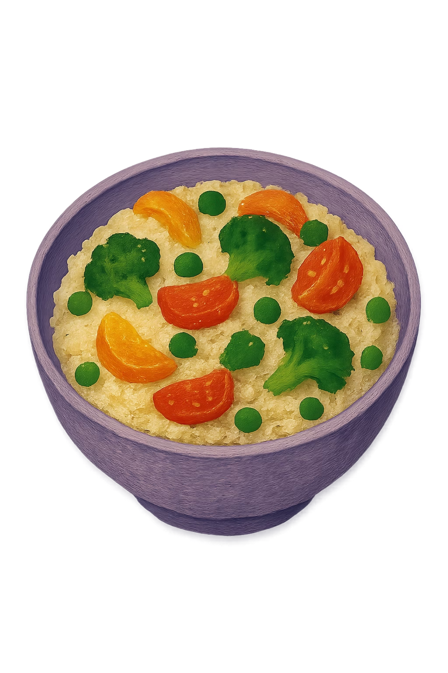
Vegetable Risotto
A warm, hearty dish packed with fresh vegetables — learn how to make it step by step, from washing the rice to the final garnish.

Slide 2
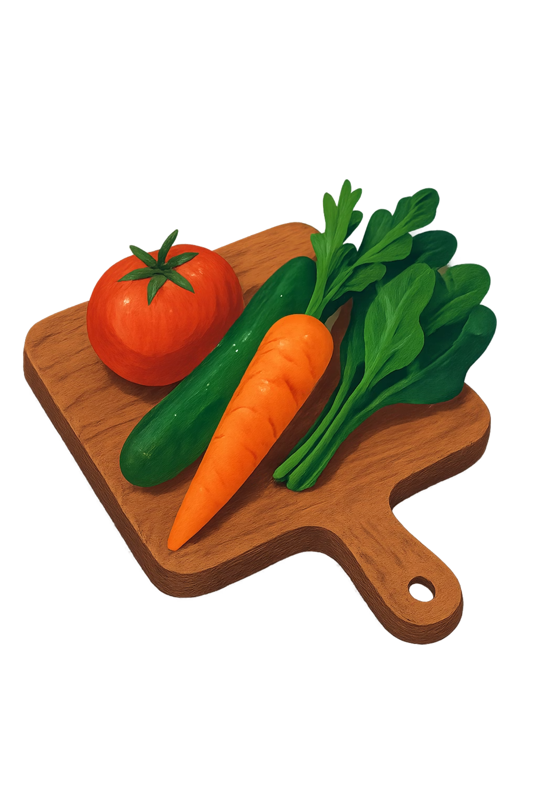
What You'll Need
🌾 Rice
Rinse thoroughly in cold water before cooking
🥕 Carrot
Peeled and cut into small, even pieces
🧅 Onion
Peeled and finely chopped
🫛 Peas
Fresh or frozen — both work great

Slide 3
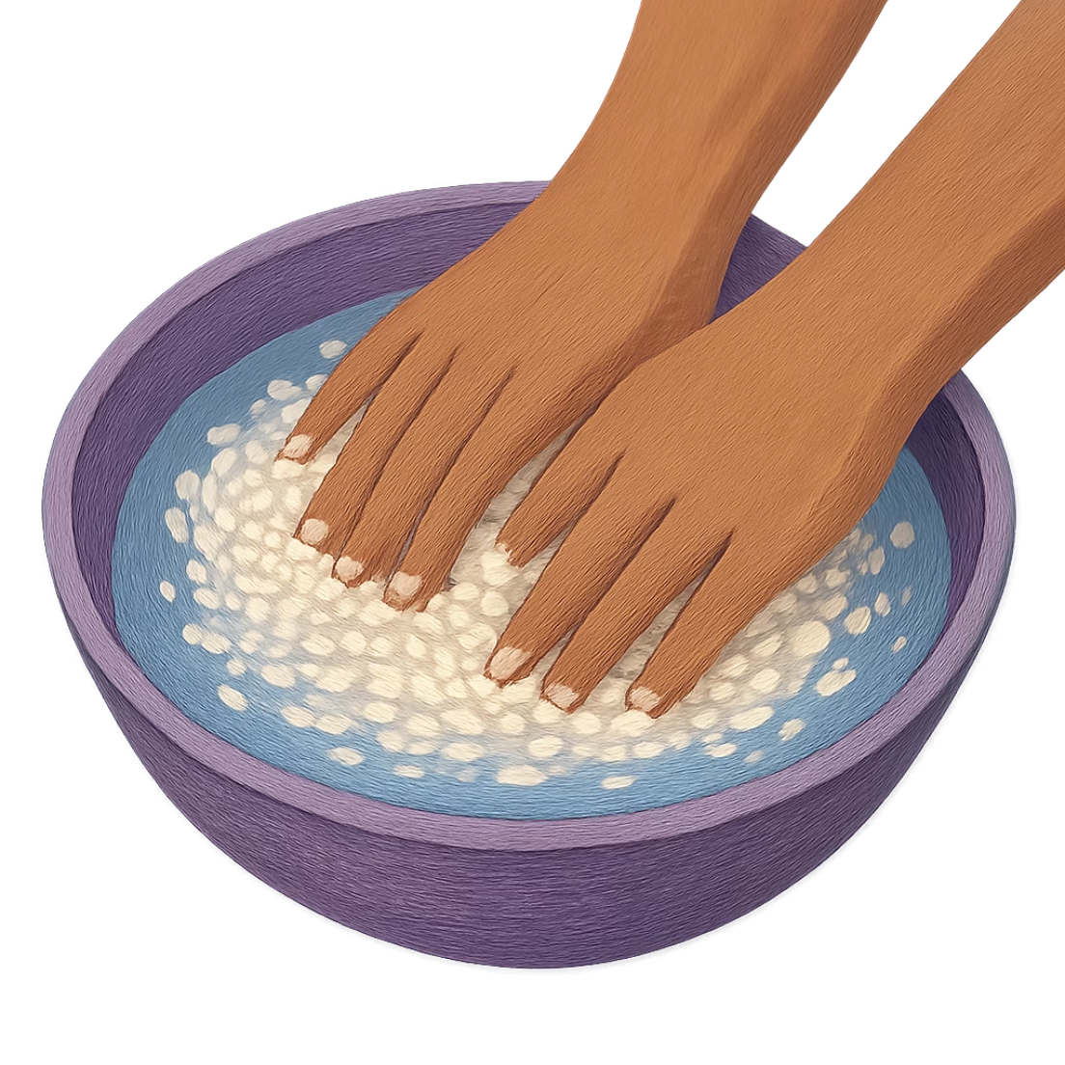

Step 1 — Prepare the Ingredients
Start with the basics
Before anything goes into the pan, preparation is key.
Wash the rice in cold water until the water runs clear
Peel and cut the carrot into small, even pieces
Peel and finely chop the onion
Clean, well-prepped ingredients make cooking smoother and the final dish more flavorful.

Slide 4
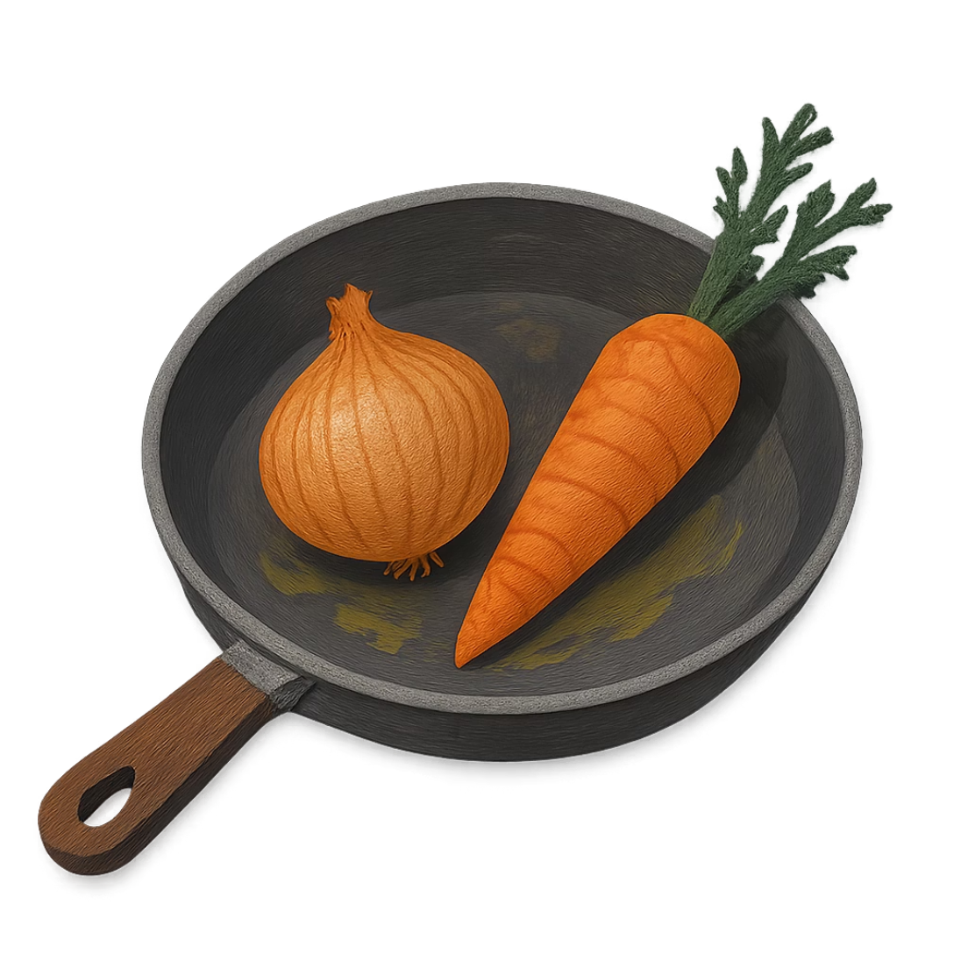
Step 2 — Sauté the Vegetables
Build the flavor base
Cooking the vegetables in oil creates a rich, aromatic foundation for the risotto.
Heat oil in a frying pan over medium heat
Add the chopped onion — cook for about 2 minutes until softened
Add the carrot and peas — cook for another 5 minutes

Slide 5
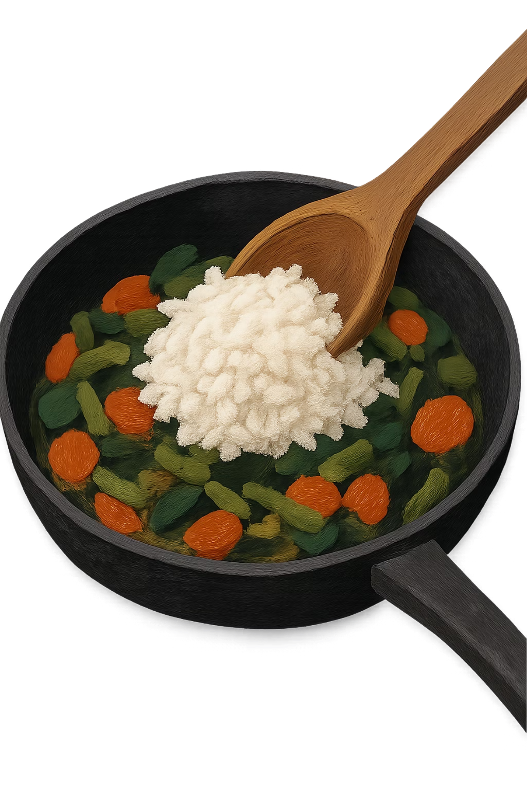
Step 3 — Add the Rice
Once the vegetables are softened and fragrant, add the washed rice directly into the pan. Mix everything together well so the rice is evenly coated with the oil and gets to know the vegetables before the liquid is added.

Slide 6
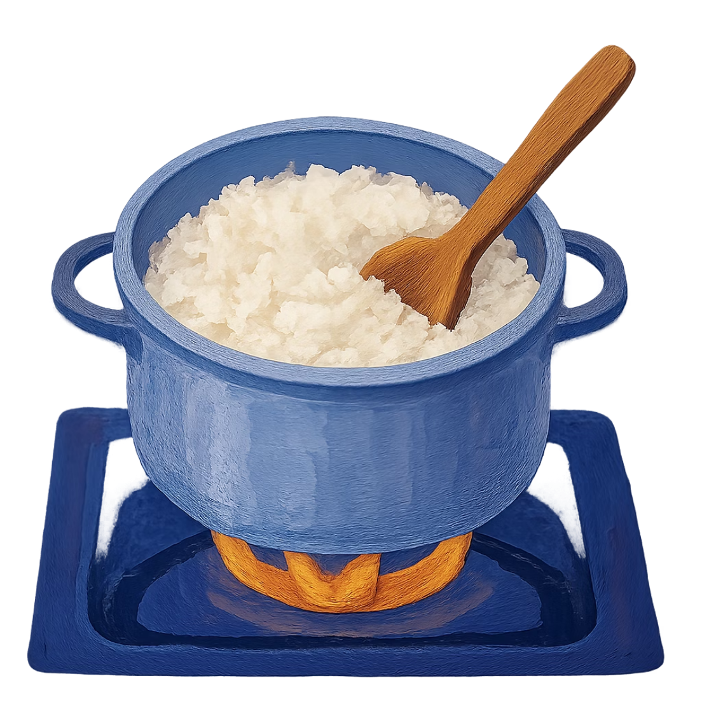

Step 4 — Cook Low and Slow
Patience makes perfect risotto
Pour in water or vegetable broth to cover the rice and vegetables.
Cook on low heat for 15–20 minutes
Stir occasionally to prevent sticking
The rice is ready when it is soft and creamy
Tip: Vegetable broth adds much more depth of flavor than plain water!

Slide 7
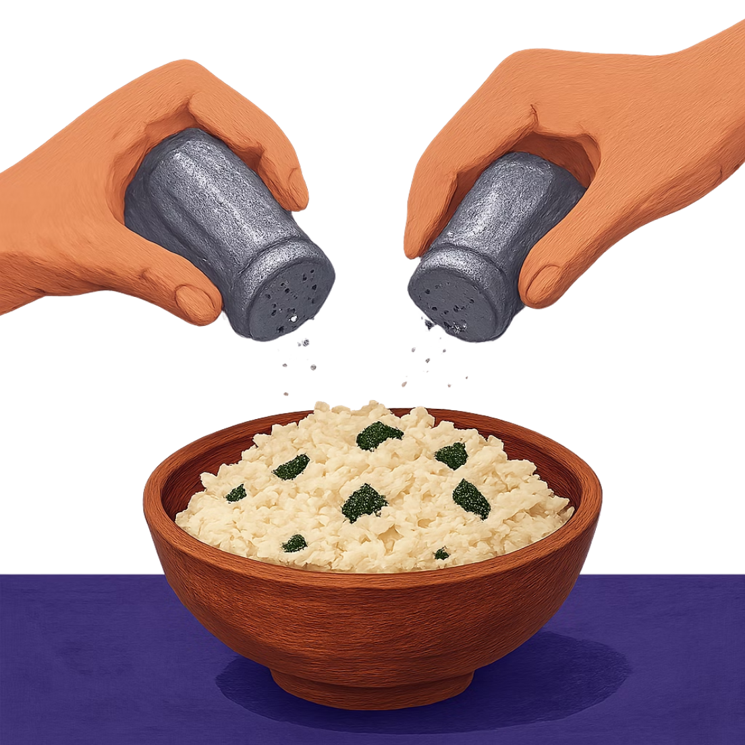
Step 5 — Season to Taste
Simple seasoning goes a long way
Once the rice is cooked through, it's time to season and finish the dish.
Add salt and pepper to taste
Give the risotto one final good stir to bring everything together
Serve immediately while it is hot and fresh

Slide 8
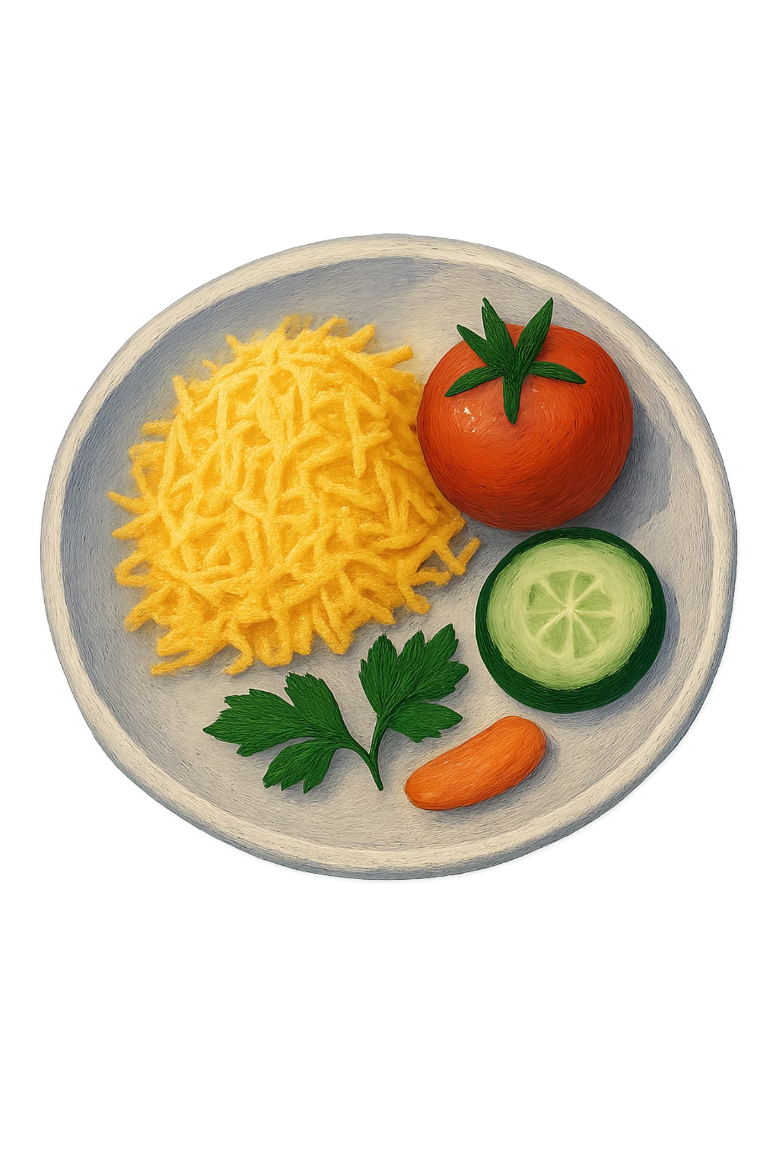

Step 6 — The Final Garnish
Presentation matters! Before serving, top your risotto with these finishing touches to add color, texture, and extra nutrition.
Broccoli
Adds a vibrant green color and a hearty bite
French Beans
Tender and fresh, a perfect finishing touch
Grated Cheese
Melts beautifully and adds rich, savory flavor
Bean Sprouts
Light and crunchy — a fresh, healthy contrast

Slide 9

The Full Recipe at a Glance
Prep
Sauté
Add Rice
Simmer
Season
Follow these six simple steps and you'll have a delicious, colorful vegetable risotto ready to enjoy every time.

Slide 10
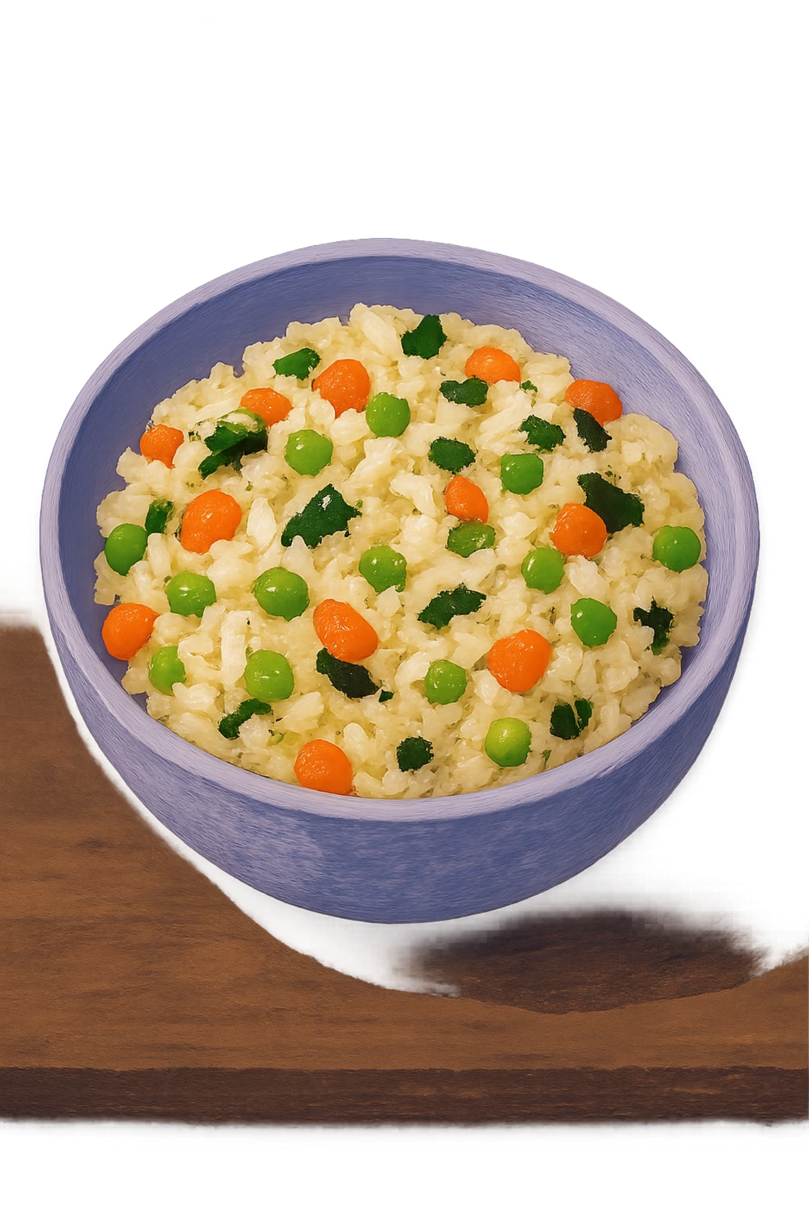
Enjoy Your Risotto!
Well done — your vegetable risotto is ready to serve! 🎉 With a little patience and fresh ingredients, this dish is both nutritious and delicious. Share it with friends and family, or enjoy it as a satisfying meal on its own.
BON APPÉTIT!

